Slide 1
Matthew Ernst EECT 111 12.14.2017
Lab Notebook

Slide 2
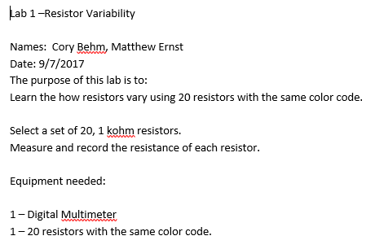
Lab 1

Slide 3
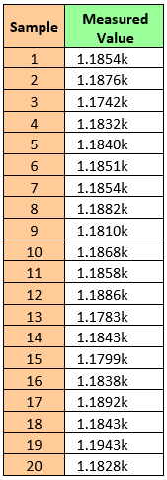
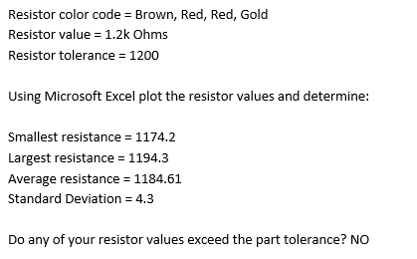
Lab 1

Slide 4
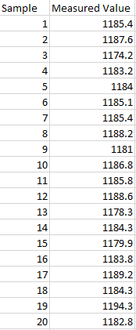
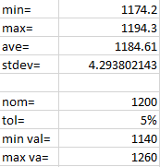
Lab 1 Excel

Slide 5
Lab 1 Observations
This lab was about measuring varying resistors. I used 20 different resistors all with the same color combination. They were all 1.2k Ohm resistors and they all averaged 1.184k Ohms. I learned about basics resistor values and the digital multimeter.

Slide 6
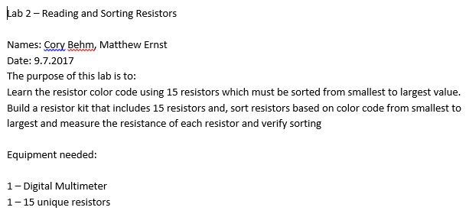
Lab 2

Slide 7
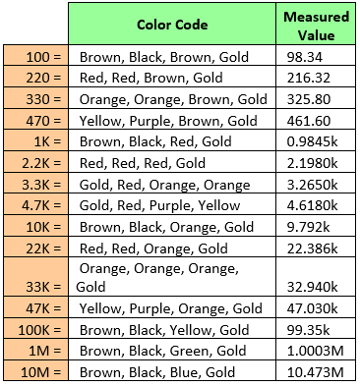
Lab 2

Slide 8
Lab 2 Observations
The objective of this lab was to learn the color code of 15 different resistors, sorted from smallest to largest. I learned about the mathematics and meaning behind the color code as a quick way to learn the resistor values. I learned more about the resistors and the digital multimeter.

Slide 9
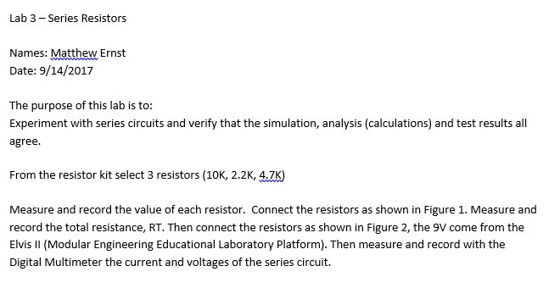
Lab 3

Slide 10
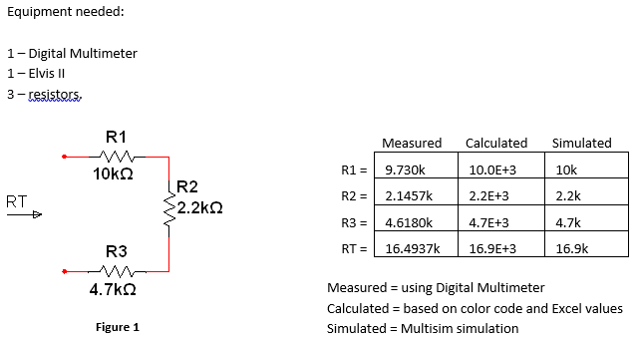
Lab 3

Slide 11
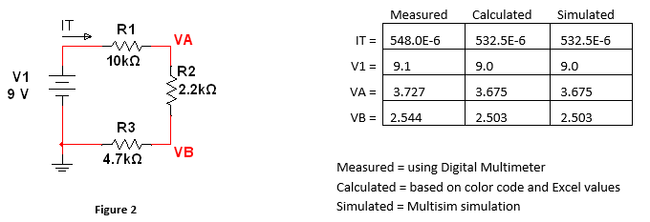
Lab 3

Slide 12
Lab 3 Observations
In this lab I learned to interact with series circuits. I was able to put resistors in series together in a circuit and use simulations and lab results to verify the results were correct.

Slide 13
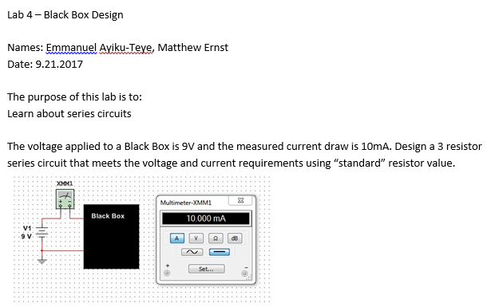
Lab 4

Slide 14
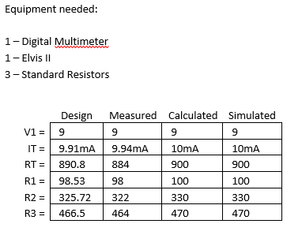
Lab 4

Slide 15
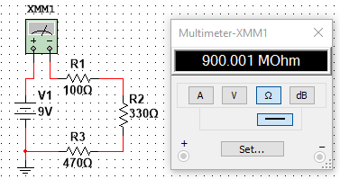
Lab 4 Multisim

Slide 16
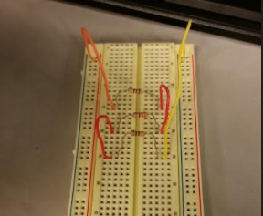
Lab 4 Picture

Slide 17
Lab 4 Observations
In this lab I learned to connect resistors together in a black box. It was a guess and check sequence of operations that resulted in the completion of the lab.

Slide 18
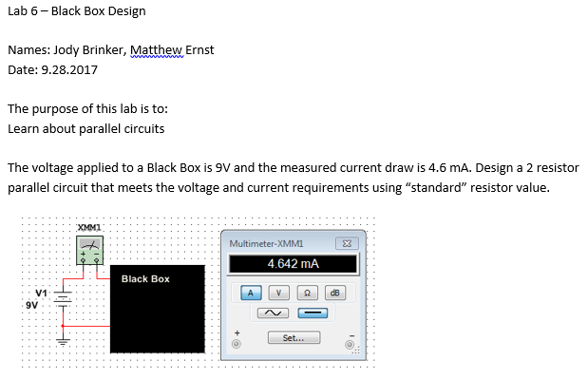
Lab 6

Slide 19
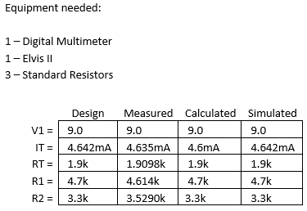
Lab 6

Slide 20
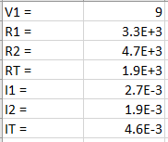
Lab 6 Excel

Slide 21
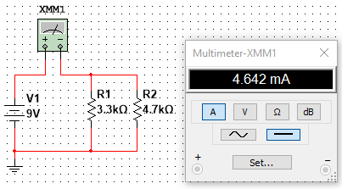
Lab 6 Multisim

Slide 22
Lab 6 Observations
In this lab I learned how to connect resistors in a parallel circuit. It was a different method and lab breadboard configuration that took a little practice. The black box ended up being a 3.3k and 4.7k resistor.

Slide 23
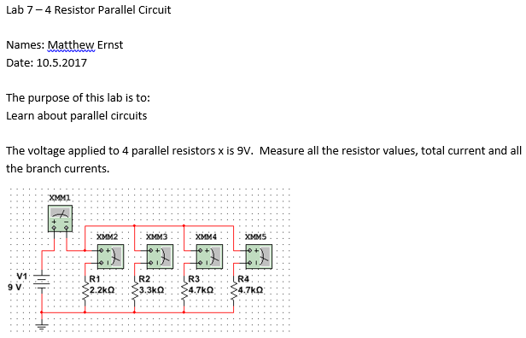
Lab 7

Slide 24
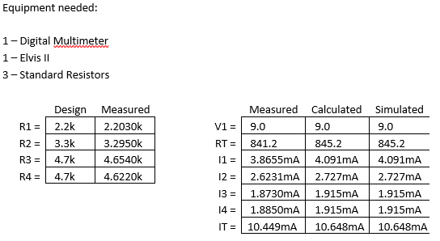
Lab 7

Slide 25
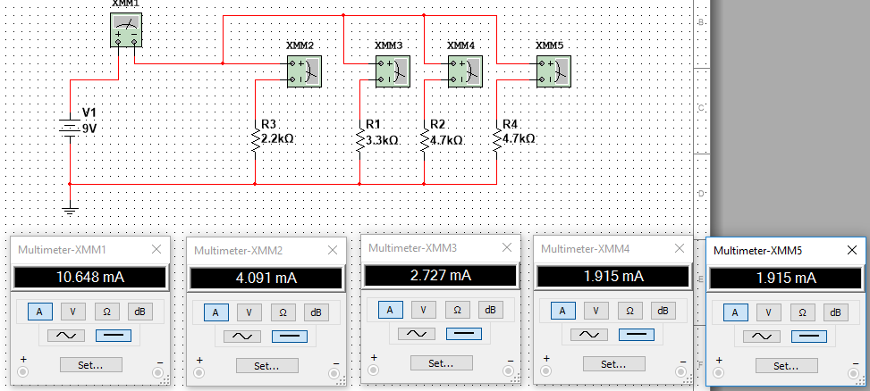
Lab 7 Multisim

Slide 26
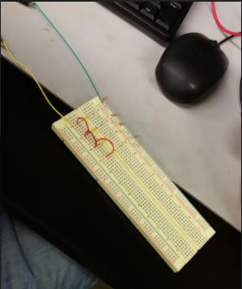
Lab 7 Picture

Slide 27
Lab 7 Observations
Through this lab we learned that having the resistors in the lab configuration in parallel read IT of about 10.4 mA. I personally learned more about circuit configurations from the multimeter to individual resistors. We also learned that as resistance goes up, current goes down, and vice versa.

Slide 28
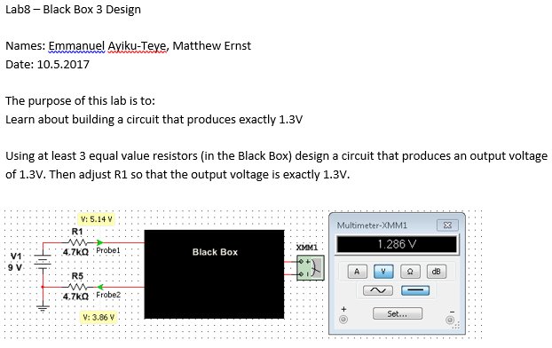
Lab 8

Slide 29
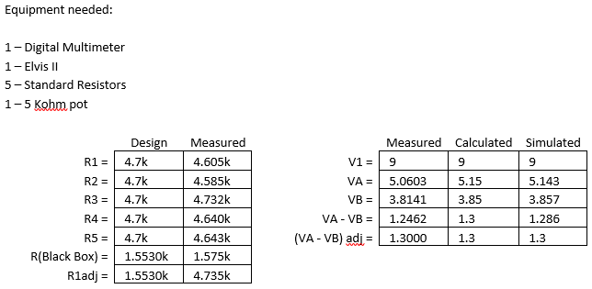
Lab 8

Slide 30
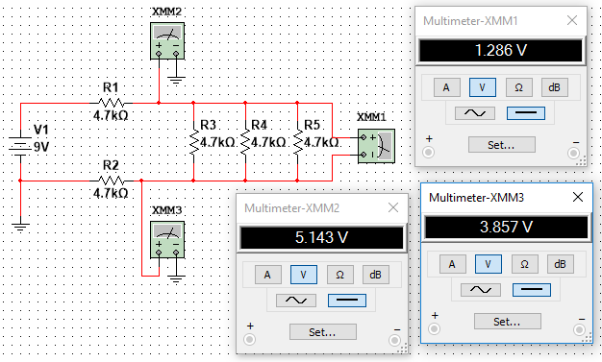
Lab 8 Multisim

Slide 31
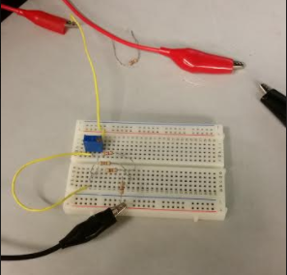
Lab 8 Picture

Slide 32
Lab 8 Observations
In this lab, I learned to connect resistors in parallel and series together. I also realized that each resistor in the black box was the exact same value as the ones on display. Some of the measurements were off but were close to the approximate values.

Slide 33
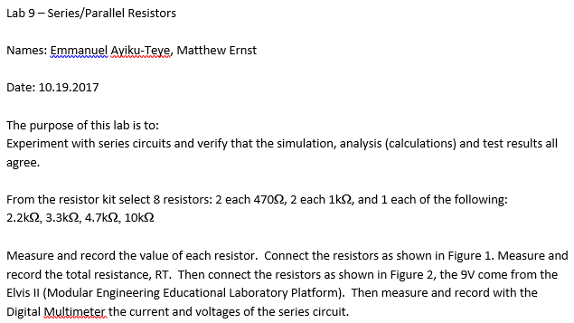
Lab 9

Slide 34
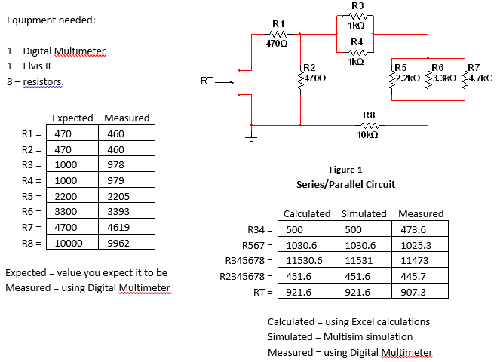
Lab 9

Slide 35
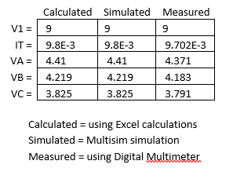
Lab 9

Slide 36
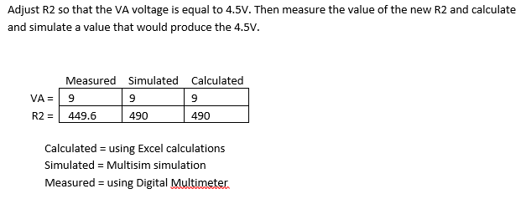
Lab 9

Slide 37
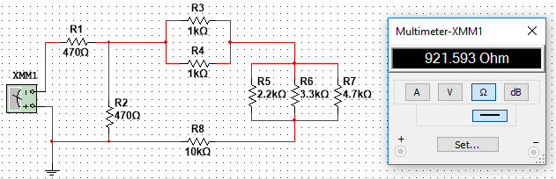
Lab 9 Multisim

Slide 38
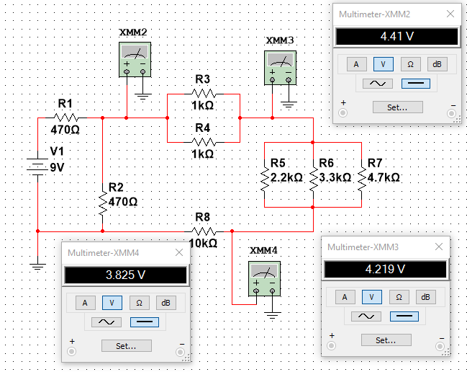
Lab 9 Multisim

Slide 39
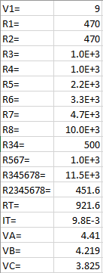
Lab 9 Excel

Slide 40
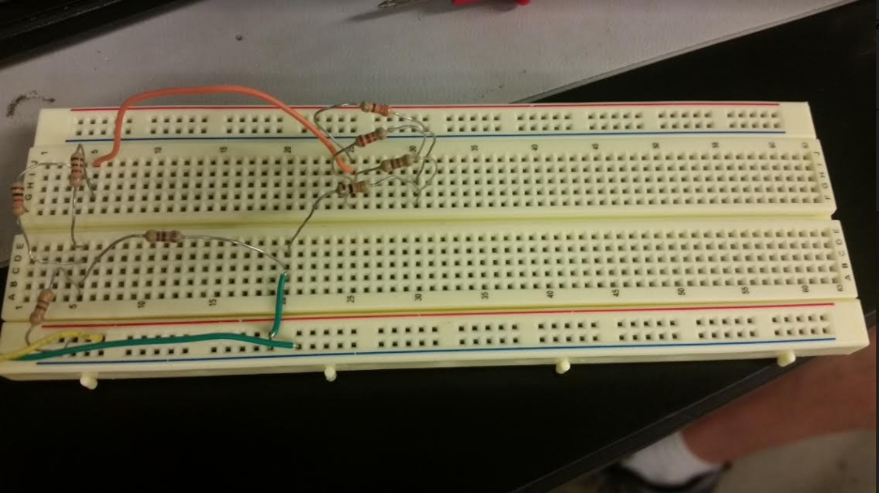
Lab 9 Picture

Slide 41
Lab 9 Observations
The objective of this lab was to experiment with series circuits and verify that the simulated, calculated, and experimental results all agree. I learned to connect series and parallel circuits altogether in one single circuit. All the results were not exactly the same but they fell within an acceptable range.

Slide 42
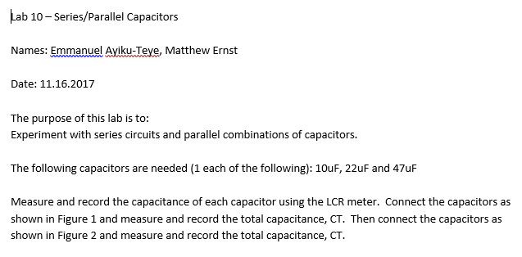
Lab 10

Slide 43
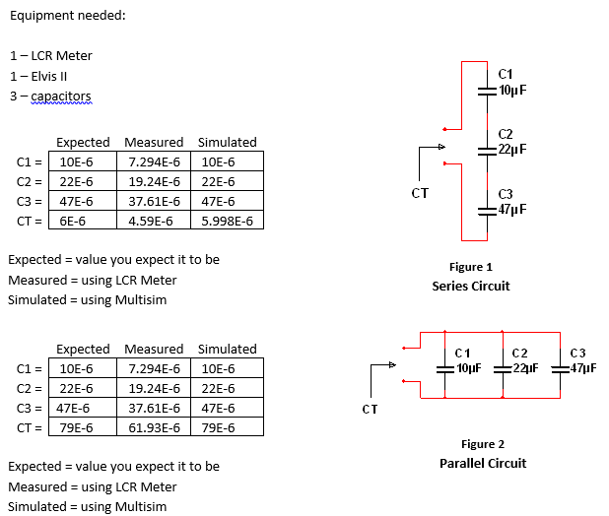
Lab 10

Slide 44
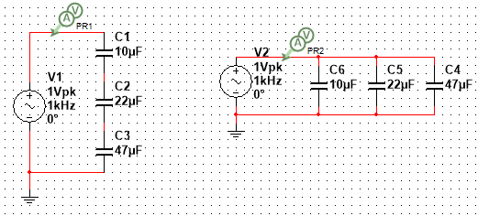
Lab 10 Multisim

Slide 45

Lab 10 Multisim

Slide 46

Lab 10 Excel

Slide 47
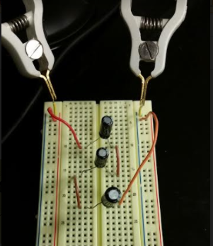
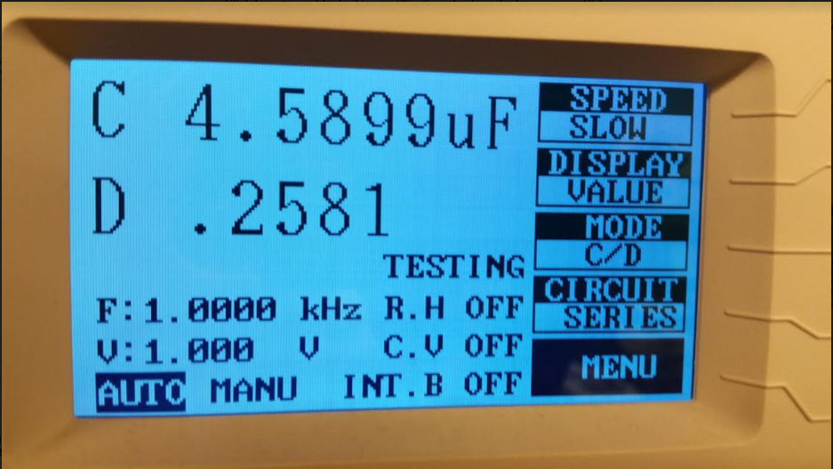
Lab 10 Picture

Slide 48
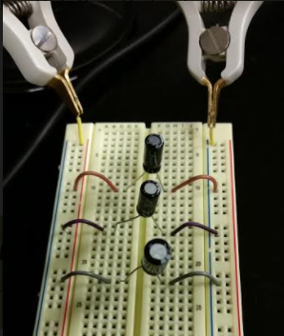
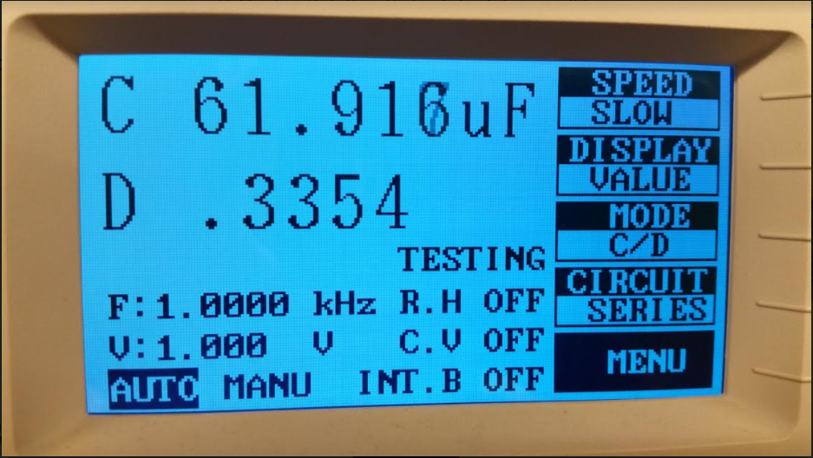
Lab 10 Picture

Slide 49
Lab 10 Observations
In Lab 10, we learned how to connect capacitors in series and parallel. We also learned how to measure the capacitors with an LCR. The results of Excel and simulated values were exactly the same, but the measured values in the lab were off. These variations could have been a result of faulty lab equipment or human error. However, the LCR measured exactly like the numbers did in Excel and multisim, so it was most likely the capacitors that were at fault.

Slide 50
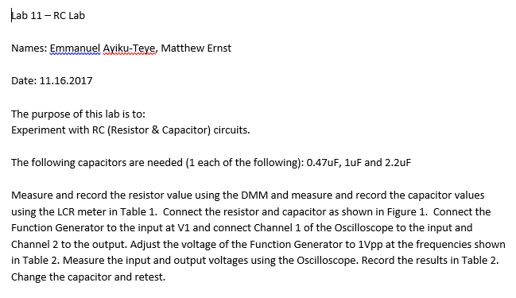
Lab 11

Slide 51
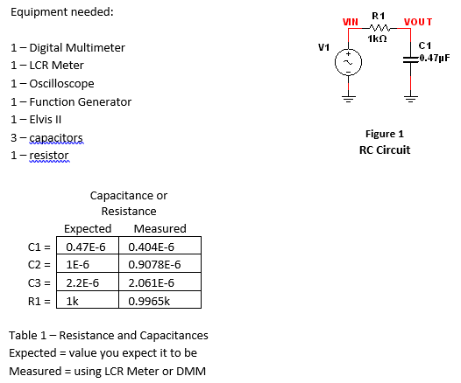
Lab 11

Slide 52
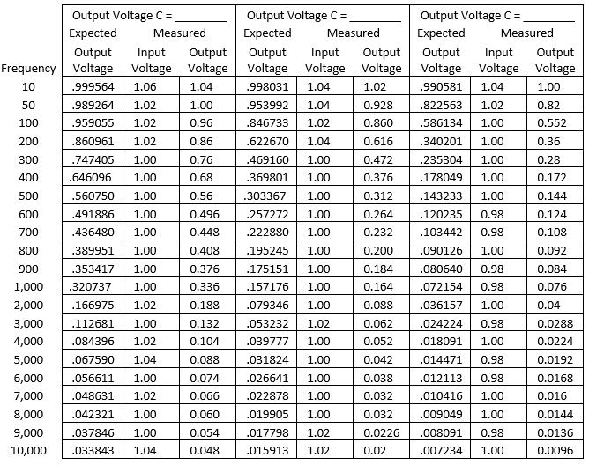
Lab 11

Slide 53
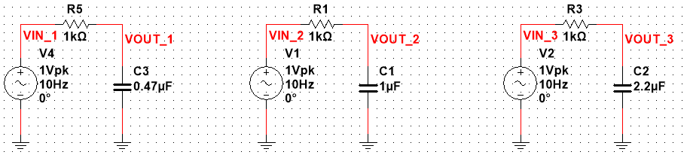
Lab 11 Multisim

Slide 54
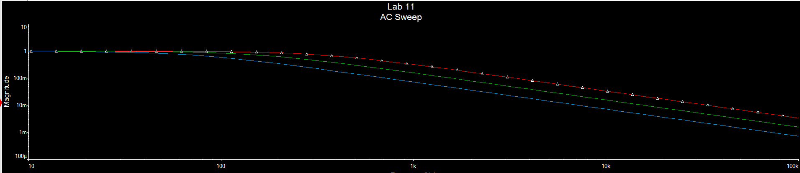
Lab 11 Multisim

Slide 55
Lab 11 Observations
In this lab we learned more about capacitors and how to use an oscilloscope. The circuit built and the observations recorded took a little time but fell within the acceptable bounds. I learned more about how to read the oscilloscope and circuit building. I also learned about a DMM and an LCR and how to use them.

Slide 56
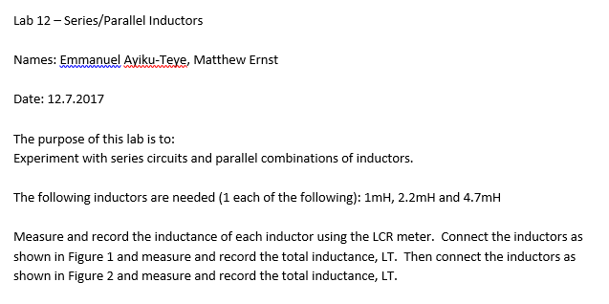
Lab 12

Slide 57
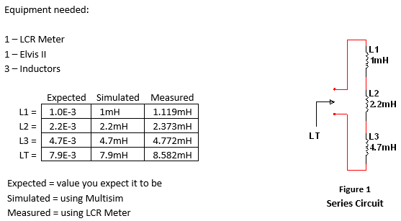
Lab 12

Slide 58
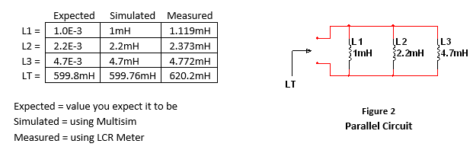
Lab 12

Slide 59
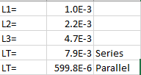
Lab 12 Excel

Slide 60


Lab 12 Multisim

Slide 61


Lab 12 Picture

Slide 62
Lab 12 Observations
In this lab I learned to connect series circuits combined with parallel inductors. It was very similar to a lab I did a few weeks ago so I learned how to deal with inductors.

Slide 63

Lab 13

Slide 64

Lab 13

Slide 65

Lab 13

Slide 66


Lab 13 Multisim

Slide 67

Lab 13 Picture

Slide 68
Lab 13 Observations
This lab was very similar to the lab involving the oscilloscope a few weeks before. I learned about inductors and how to connect them together in series and in parallel.

